Slide 1
INTRODUCTION
TIME SERIES ANALYSIS WITH R

Slide 2
About me:
From Budapest, Hungary
BSc in physics
MSc in applied mathematics
Working as a software engineer
Special addiction to algorithms + AI + models concerning quantitative finance such as the Black-Scholes model or credit risk, Merton-model

Slide 3
About the course:
Time series analysis in R
Correlation and stationarity
Random walk and white noise
Autoregressive (AR) model
Moving average (MA) model
Autoregressive moving average (ARMA) model
Autoregressive Integrated Moving Average (ARIMA) model
Auroregressive Conditional Heteroskedastic (ARCH) model
Generalised Autoregressive Conditional Heretoskedastic (GARCH) model

Slide 4
HD option for videos

Slide 5
Time Series Analysis
We are going to deal with historical data: data present on Yahoo Finance
→ popular approach in quantitaive finance
→ form of a technical analysis: we assume all the information is
contained in stock prices in the past
We analyze the data: we make predictions concerning the future !!!
BUT we have the assumption: the time series are the realisations of
sequences of random variables
SO IT IS VERY SIMILAR TO THE QUANTITATIVE APPROACH

Slide 6
Time Series Analysis
TIME SERIES FEATURES:
1.) autocorrelation: time series related observations
that are close together in time are usually correlated
2.) trends: a trend is the general direction of a market or a price
of a given asset (stock for example)
~ it is quite common in financial series
For example: seasonal variation in commodities,
annual temperature variation for natural gas
r r r r ... r
1
2
3
4
n
daily
return
daily
return
daily
return
daily
return
daily
return

Slide 7
Time Series Analysis
AUTOCORRELATION - „SERIAL CORRELATION”
identifying trends or seasonal effects is relatively easy
we can decompose the given series into these components
BUT we are left with a random component
INTUITION: let’s model this random component with independent
random variables drawn from a given probability distribution
THIS IS NOT A GOOD MODEL !!!
in finance this random component has correlation
We have to learn more about these correlations
to end up with good trading strategies

Slide 8



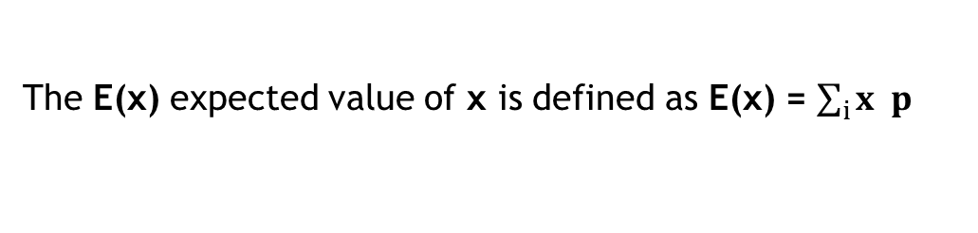



Time Series Analysis
MEAN, VARIANCE AND COVARIANCE
The mean or expected value E(x) of an x random variable is
the mean average value in the population
E(x) = μ „expected value”
Let x be a random variable with a finite number of finite outcomes
occuring with probabilities
x
x
x ... x
p
p
p ... p
1
2
3
k
1
2
3
k
The E(x) expected value of x is defined as E(x) = $\sum_{i}{x p}$
i
i
Example: x is the outcome of a roll of a die. The outcomes can be
{1,2,3,4,5,6}. The E(x) expected value of x is:
$$\frac{1}{6}$$
$$\frac{1}{6}$$
$$\frac{1}{6}$$
$$\frac{1}{6}$$
$$\frac{1}{6}$$
$$\frac{1}{6}$$
E(x) = 1 + 2 + 3 + 4 + 5 + 6 = 3.5

Slide 9
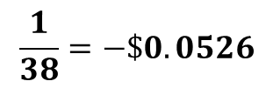

Time Series Analysis
MEAN, VARIANCE AND COVARIANCE
Example: roulette game consists of a wheel with 38 numbered pockets.
Let x represents the outcome of $1 on a single number.
x: amount of money we win/lose
$$\frac{37}{38}$$
$$\frac{1}{38}=−\$0.0526$$
E(x) = -$1 + $35
when you
lose
when you
win

Slide 10
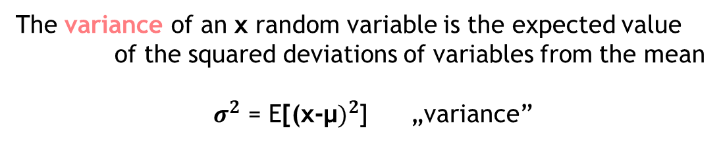
Time Series Analysis
MEAN, VARIANCE AND COVARIANCE
The variance of an x random variable is the expected value
of the squared deviations of variables from the mean
$σ^{2}$ = E[(${\text{x}\text{−}\text{μ})}^{2}$] „variance”
~ the variance is always positive: we can define the
standard deviation as the square root of variance
σ „standard deviation”

Slide 11
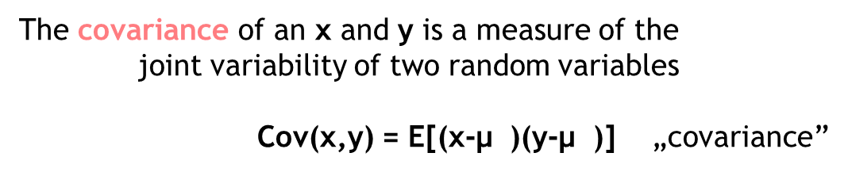
Time Series Analysis
MEAN, VARIANCE AND COVARIANCE
The covariance of an x and y is a measure of the
joint variability of two random variables
Cov(x,y) = E[(x-$\text{μ}$ )(y-$\text{μ}$)] „covariance”
x
y
~ covariance defines how two variables move together
There is one issue when dealing with covariance:
→ it is a dimensional measure
→ it is not normalized: it is hard to compare
datasets with large differences in spread
THIS IS WHY CORRELATION IS PREFERRED !!!

Slide 12

Time Series Analysis
MEAN, VARIANCE AND COVARIANCE
The correlation is a dimensionless measure of how two random
variables vary together
E[(x-$\text{μ}$ )(y-$\text{μ}$)]
δ(x,y) =
x
y
„correlation” [-1,1]
σ σ
x
y
δ(x,y) > 0 positive linear relationship between variables
δ(x,y) = 0 no relationship between variables
δ(x,y) < 0 negative linear relationship

Slide 13
Time Series Analysis
STATIONARITY IN TIME SERIES
We have a stock market
related time series, where
the x(t) values are the
given stock prices
x(t)
x
x
x ...
x
0
1
2
k
t
x
x
x
x
0
1
2
k

Slide 14
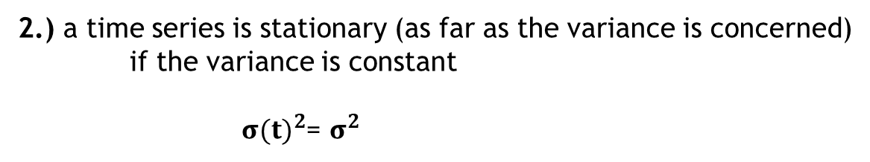
Time Series Analysis
STATIONARITY IN TIME SERIES
The mean of the given x(t) time series is: E(x(t)) = μ(t)
1.) a time series is stationary (as far as the mean is concerned)
if the mean is constant
μ(t) = μ
The variance of the given x(t) time series is: ${σ(t)}^{2}$ = E[(${\text{x}\text{(}\text{t}\text{)−}\text{μ})}^{2}$]
2.) a time series is stationary (as far as the variance is concerned)
if the variance is constant
${σ(t)}^{2}$= $σ^{2}$
BUT some x(t) observations may be correlated: so we may over-
or underestimate the actual variance

Slide 15

Time Series Analysis
STATIONARITY IN TIME SERIES
Second order stationarity → if we assume that the x(t) series is
stationary in the mean AND stationary in the variance:
A given x(t) time series is second order stationary if the correlation between the
observations is the function of the lag exclusively
~ so the function of time steps separating each sequential observations
Autocovariance (serial covariance) for second order stationary time series:
Cov = E[ ( x – $\text{μ}$)( x - $\text{μ}$)]
k
t
t+k
Autocorrelation for second order stationary time series:
Cov
δ =
k
k
2
σ

Slide 16
Time Series Analysis
STATIONARITY IN TIME SERIES
non-stationary process stationary process
(random walk)
transformation such as
y(t)-y(t-1) differencing
(white noise)
non-stationary data is unpredictable and can not be modeled
we tranform non-stationary processes into stationary processes
~ thus we can build models !!!

Slide 17
Time Series Analysis
STATIONARITY IN TIME SERIES
x(t)
x
x
x
x
x
x
1
2
3
4
5
6
x
x
x
x
x
x
1
2
3
4
5
6
In this case we shift the series 1 step, so lag=1
t
x
x
x
x
0
1
2
k

Slide 18
Time Series Analysis
STATIONARITY IN TIME SERIES
x(t)
x
x
x
x
x
x
1
2
3
4
5
6
x
x
x
x
x
x
1
2
3
4
5
6
In this case we shift the series 2 steps, so lag=2
t
x
x
x
x
0
1
2
k

Slide 19
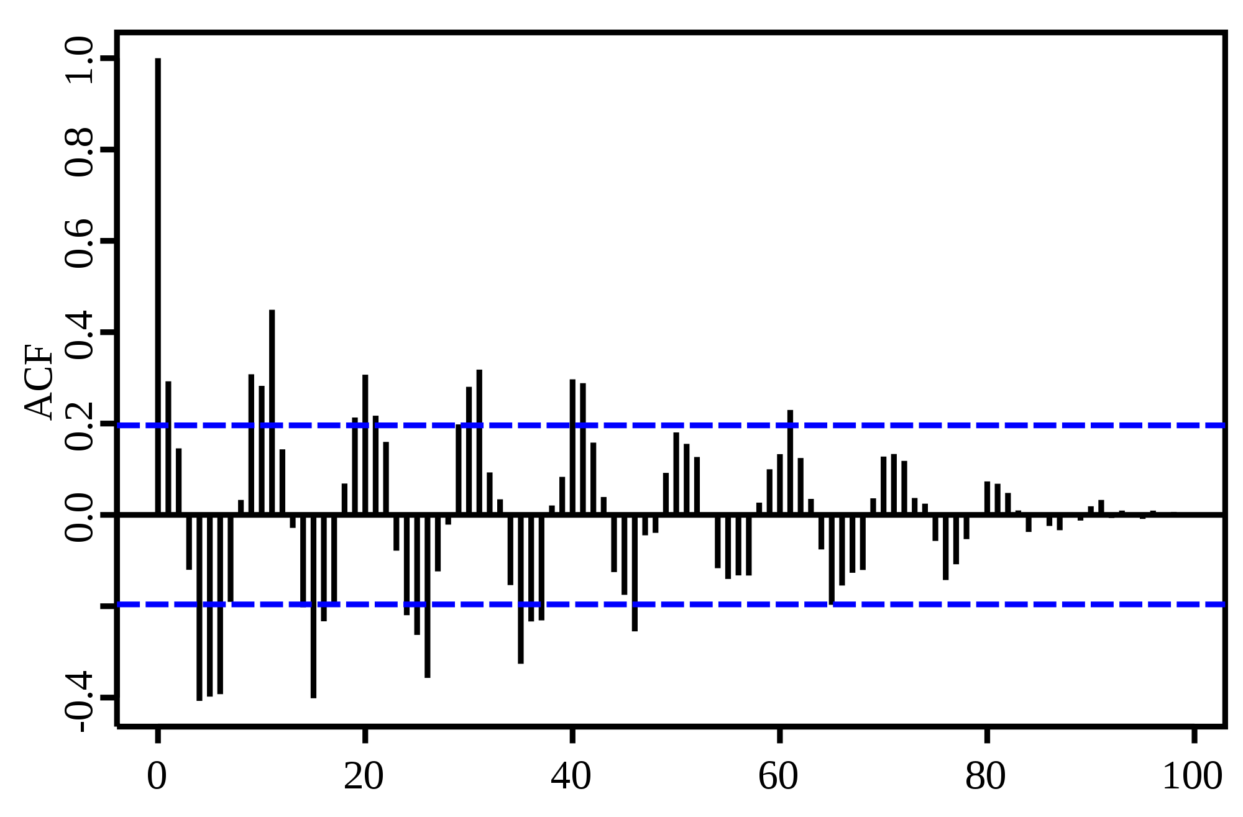
Time Series Analysis
CORRELOGRAM
Basically, the correlogram (or autocorrelation plot) is a plot of the
autocorrelations versus the time lags

Slide 20
Time Series Analysis
CORRELOGRAM
Basically, the correlogram (or autocorrelation plot) is a plot of the
autocorrelations versus the time lags
x
x
x
x
x
x
1
2
3
4
5
6
x
x
x
x
x
x
1
2
3
4
5
6
In this case we shift the series 0 step, so lag=0

Slide 21
Time Series Analysis
CORRELOGRAM
Basically, the correlogram (or autocorrelation plot) is a plot of the
autocorrelations versus the time lags
x
x
x
x
x
x
1
2
3
4
5
6
x
x
x
x
x
x
1
2
3
4
5
6
In this case we shift the series 1 step, so lag=1

Slide 22
Time Series Analysis
CORRELOGRAM
Basically, the correlogram (or autocorrelation plot) is a plot of the
autocorrelations versus the time lags
x
x
x
x
x
x
1
2
3
4
5
6
x
x
x
x
x
x
1
2
3
4
5
6
In this case we shift the series 2 steps, so lag=2

Slide 23
Time Series Analysis
CORRELOGRAM
The acf() function has something
to do with stationarity
stationary times series: the acf()
value drops to zero quickly
non-stationary series: the acf()
value decreases slowly

Slide 24
Time Series Analysis
QUANTITATIVE TRADING AND AUTOCORRELATION
Autocorrelation is useful for technical analysis: we can analyze how
past prices (or price changes) affected future prices
given stock has high positive autocorrelation:
If we witness the stock making solid gains over the past days
we may expect the movements to match those of the
lagging time series move upwards

Slide 25
Time Series Analysis
So we know that financial related time series has autocorrelation ...
We want to end up with models capable of explaining
why this is happenning !!!
FIRST MODEL: let’s assume stock prices are random
we find a given model: check whether the model explains
the serial correlation or not
by fitting the models (to historical data), we are
reducing serial correlation
we will construct more and more complex approaches,
eventually we can explain serial correlation
Models: AR, MA, ARMA, ARCH, ...

Slide 26
Time Series Analysis
We can define the difference between the actual values x(t) and the
values predicted by a given model x’(t)
y(t) = x(t) – x’(t) „residual error series”
There can be (when dealing with financial data usually this is the case)
serial correlations between these error terms
→ if there is serial correlation for the residuals: good indicator
that our model is not good
A GOOD MODEL CAN EXPLAIN THIS AUTOCORRELATION

Slide 27
Time Series Analysis
We can define the difference between the actual values x(t) and the
values predicted by a given model x’(t)
y(t) = x(t) – x’(t) „residual error series”
There can be (when dealing with financial data usually this is the case)
serial correlations between these error terms
→ if there is serial correlation for the residuals: good indicator
that our model is not good
A GOOD MODEL CAN EXPLAIN THIS AUTOCORRELATION
In this case, the y(t) residuals are serially uncorrelated.
What does it mean? Serially uncorrelated residual series are
independent and drawn from some probability distribution

Slide 28
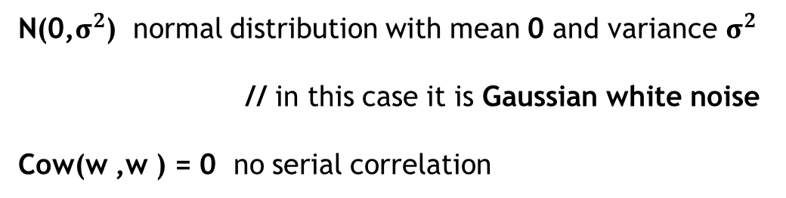
White Noise
So the simplest model is to generate random variables: white noise
WHITE NOISE: if we have a time series w k=1...n where the element
of the series are independent, identically distributed and no serial correlation
k
N(0,$σ^{2}$) normal distribution with mean 0 and variance $σ^{2}$
// in this case it is Gaussian white noise
Cow(w ,w ) = 0 no serial correlation
i
j
We can use white noise as a model for the y(t) residuals
~ we can fit models (AR, MA, GARCH) to our observed time series
If the model is good: the autocorrelation of y(t) residuals is
like for the white noise process !!!

Slide 29
White Noise
μ = E[w ] = 0 mean of a white noise process
δ = Cor(w , w ) = 1 (k=0) or 0 (k=1,2,...)
w
t
k
t
t+k

Slide 30
Random Walk
We can define a random walk with white noise: the actual x(t) value of the
series is the x(t-1) previous value plus some random fluctuation
x = x + w
t
t-1
t
actual value
of a given stock
previous value
of a given stock
random term
(white noise)
~ the previous value of the stock can be recursively
decomposed into a previous value and a random term
RANDOM WALK IS THE SUM OF WHITE NOISE SERIES !!!

Slide 31
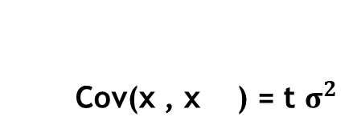
Random Walk
The mean of the random walk process is 0 BUT the
autocorrelation is not constant
~ it means random walk is not a stationary process
Cov(x , x ) = t $σ^{2}$
t
t+k

Slide 32
Random Walk
So our first model is random walk: we assume that assets (stocks)
can be modeled with this process
How to test it?
1.) download data from Yahoo Finance
2.) calculate the differences: w(t)-w(t-1)
3.) let’s check whether the residuals are something
like white noise ... we know the correlogram
of white nose
x - x = w
t
t-1
t

Slide 33
Autoregressive Model (AR)
Random walk is a good model BUT it is not always the
perfect model !!!
~ we are after a time series model thats capable of explaining
all the serial correlation
What is the problem with these models? (random walk, AR, MA)
VOLATILITY CLUSTERING
Simple models assume the volatility to be constant, but this
is not true: the volatility is not constant in time
// this is called conditional heteroskedasticity
So even more complicated models are needed: ARCH and
GARCH models are quite good
~ used on a daily basis in quantitative finance

Slide 34
Autoregressive Model (AR)
random walk = deterministic part + stochastic part
(previous observation) (white noise)
1.) first approach: let’s consider more observations
in the past
AUTOREGRESSIVE MODEL
2.) second approach: let’s add more white noise terms
MOVING AVERAGE MODEL

Slide 35
Autoregressive Model (AR)
Autoregressive model is the generalization of the random walk
x = α x + ... + α x + w
t
1
t-1
p
t-p
t
this is called an autoregressive model of order p
a random walk is AR(1) where α=1
so we came to the conclusion that a random walk
is not able to explain autocorrelation all the time
~ we have to modify the model
Autoregressive model is not always stationary !!!
(of course, random walk itself is not stationary)

Slide 36
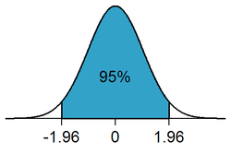
Autoregressive Model (AR)
Why to use (-1.96,1.96) when dealing with confidence intervals?
Because 95% of the area under the normal distribution
lies within 1.96 standard deviations from the mean

Slide 37
Akaike Information Criterion (AIC)
How to decide the order of a given model?
For example: we have used AR(p) autoregressive algorithms
But how to know what p value to choose?
AIC is an estimator of a the relative quality of a model
we can select the best models based on this criterion
BUT it tells nothing about the model: only relative to others
// so if all the possible models fit poorly, AIC will not warn you
it penalises models that are overfit (so penalises models with
lots of parameters) but of course rewards goodness of a fit
THE LOWER THE BETTER
AIC = 2k – 2 ln(L’) for maximum likelihood function
L’ is the maximum value of the likelihood function

Slide 38
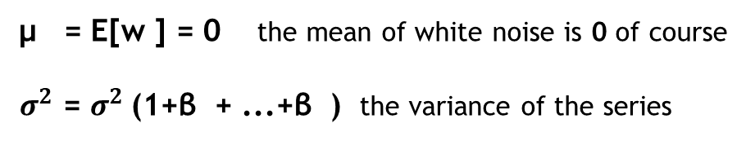
Moving Average Model (MA)
Autoregressive model is not always working fine: because of
heteroskedastic behavior of assets
~ non-stationary processes with varying variance
→ this model combines white noise terms in the past
x = w + β w + ... + β w
t
t
1
t-1
q
t-q
μ = E[w ] = 0 the mean of white noise is 0 of course
$σ^{2}$ = $σ^{2}$(1+β + ...+β ) the variance of the series
x
t
2
2
w
1
q

Slide 39
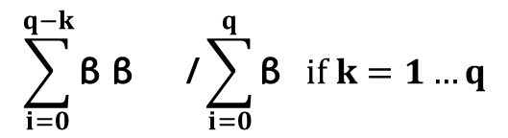
Moving Average Model (MA)
Autoregressive model is not always working fine: because of
heteroskedastic behavior of assets
~ non-stationary processes with varying variance
→ this model combines white noise terms in the past
x = w + β w + ... + β w
t
t
1
t-1
q
t-q
1 if k=0 // as always
Unlike white noise, there are
non-zero autocorrelation values
when 1<k<q. So if there is q non-zero
values exist: we can fit a MA(q) model
δ =
$$\sum_{i=0}^{q−k}{\text{β} \text{β} \text{ /}}\sum_{i=0}^{q}{\text{β} } if k=1…q$$
2
k
i
i+k
i
0 if k>q

Slide 40
Autoregressive Moving Average Model
Maybe we should combine AR(p) and MA(q) models in order to
end up with a better model
x = α x + ... + α x + w
+ β w + ... + β w
t
1
t-1
p
t-p
t
1
t-1
q
t-q
AR(p)
MA(q)
constructed in 1970 by Box and Jenkins
w(t) white noise terms are assumed to be independet
identically distributed random variables
how to find q and p parameters? With acf()
plot and with AIC !!!

Slide 41

Ljung-Box test
Statistical test of whether any of a group of autocorrelations of a time series
are different from zero
→ does not test each individual lag for randomness but tests the
randomness over a group of lags
$$\sum_{k=1}^{h}{\frac{\text{δ}}{n−k}}$$
2
Q = n(n+2)
k
H : null hypothesis is that the time series at each lag has no
autocorrelation so the data at each lag are independent
and identically distributed (iid)
0
2
How to decide? Q > Χ
α,h
chi-squared distribution with h degree of freedom
at the 100(1-α)-th percentile

Slide 42
Ljung-Box test
p-value < 0.05
You can reject the H null hypothesis assuming a
5% chance of making a mistake
~ so there is some serial correlation !!!
0
p-value > 0.05
Not enough statistical evidence to reject the H null hypothesis so
we can not assume that the values are dependent
0
So we can only prove the dependence with Ljung-Box test but
can not prove the independence of the values in the time series

Slide 43
Autoregressive Integrated Moving Average Model (ARIMA)
With the help of ARIMA(p,d,q) models we are able to reduce a
non-stationary time series into a stationary one
non-stationary process stationary process
(random walk)
transformation such as
y(t)-y(t-1) differencing
(white noise)
non-stationary data is unpredictable and can not be modeled
we tranform non-stationary processes into stationary processes
~ thus we can build models !!!
D x = x - x = w
differencing for random walk
t
t
t-1
t

Slide 44
Autoregressive Integrated Moving Average Model (ARIMA)
With the help of ARIMA(p,d,q) models we are able to reduce a
non-stationary time series into a stationary one
non-stationary process stationary process
(random walk)
transformation such as
y(t)-y(t-1) differencing
(white noise)
ARIMA model use differencing repeatedly d times
in order to end up with a stationary series
d
D x = w
t
t-1

Slide 45
Autoregressive Integrated Moving Average Model (ARIMA)
A given x time series is an ARIMA model of order p,d,q if
D x is an ARMA model of order p,q
t
d
t
so we just have to apply repeated differencing
until we can eliminate all serial correlation
diff(x,d=5) we can do repeated differencing in R

Slide 46
Conditional Heteroskedasticity
The main problem with time series models: they do not
care about volatility clustering
VOLATILITY IS NOT CONSTANT !!!
Heteroskedasticity is when the standard deviation of a given
variable is non-constant
1.) unconditional heteroskedasticity: when future periods of
high and low volatility can be identified
2.) conditional heteroskedasticity: cannot identify
future periods of volatility

Slide 47
Conditional Heteroskedasticity
WHY TO BOTHER WITH VOLATILITY?
1.) one of the most important parameters regarding
Black-Scholes model is volatility
How to calculate volatility? We have to come up
with a model ...
2.) volatility is important when dealing with risk
Value at Risk (VaR) can be calculated with
heteroskedastic models that models volatility quite fine

Slide 48
Conditional Heteroskedasticity
If the variance is not constant: it means the given x(t)
time series is not stationary
seasonal trend → variance increases with the trend !!!
~ it is a non-stationary process
HARD TO DETECT HETEROSKEDASTICITY
~ the plot can be very similar to a stationary
white noise process: we have to analyze the square of
the y(t) = x(t) - x’(t) residual series
ARCH and GARCH models are dealing with the residul series ...
For homoskedastic series the residual series is (~) the white noise
~ heteroskedastic series: the variance is changing in time

Slide 49
Autoregressive Conditional Heteroskedastic Model (ARCH)
SO HOW TO MODEL VARIANCE?
→ a good approach is to use an autoregressive AR process
for modeling the change in variance
→ actual value of variance (volatility) depends on past values

Slide 50
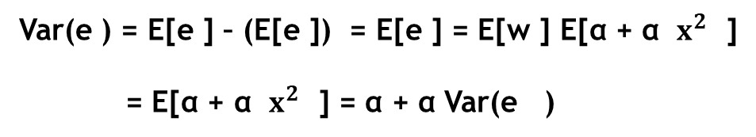

Autoregressive Conditional Heteroskedastic Model (ARCH)
e = σ w
ARCH(1) model
t
t
t
$σ^{2}$ = α + α $x^{2}$
t
0
1
t-1
It is not that intuitive at first glance but the variance of ARCH(1)
follows an AR(1) process
2
2
2
2
Var(e ) = E[e ] – (E[e ]) = E[e ] = E[w ] E[α + α $x^{2}$ ]
= E[α + α $x^{2}$ ] = α + α Var(e )
t
t
t
t
t
0
1
t-1
0
1
t-1
0
1
t-1
~ so for an ARCH(p) model the variance follows
an AR(p) process

Slide 51
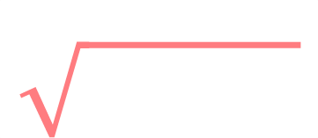

Autoregressive Conditional Heteroskedastic Model (ARCH)
$$\sum_{i=1}^{p}{}$$
2
e = w
α +
α e
ARCH(p) model
t
t
0
p
t-i
An ARCH(p) model takes volatility clustering into account
~ the model itself applies an AR(p) model to
the variance of the series
good model, can explain volatility clustering
large shocks tend to be followed by another large shock
(2008 financial crisis)

Slide 52
Autoregressive Conditional Heteroskedastic Model (ARCH)
$$\sum_{i=1}^{p}{}$$
2
e = w
α +
α e
ARCH(p) model
t
t
0
p
t-i
An ARCH(p) model takes volatility clustering into account
~ the model itself applies an AR(p) model to
the variance of the series
The α parameters are greater than zero
Why? Because variances are greater than zero
~ otherwise we may end up with negative volatility
i

Slide 53
Autoregressive Conditional Heteroskedastic Model (ARCH)
We are not able to apply ARCH/GARCH models to any series ...
→ these heteroskedastic models can be applied when
there is already a fitted model leaving the residuals
looking like white noise
→ hard to detect volatility clustering: we have to examine the
square of the residuals (sometimes residuals are not
autocorrelated but the square residuals are)
→ plus we have to make sure the mean of the residuals is zero
So ARCH/GARCH models can be applied to series that do not have any
trends so there is no autocorrelation
~ a good idea is to use ARMA, ARIMA first

Slide 54


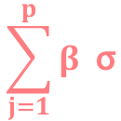
Generalized Autoregressive Conditional Heteroskedastic Model (GARCH)
ARCH(p) model uses AR(p) for modeling the variance ...
why not combine it with MA(q) as well?
GARCH(p,q) → let’s model variance with an ARMA(p,q) model so
combining AR(p) and MA(q) models
e = σ w
GARCH(p,q) model
t
t
t
$$\sum_{i=1}^{q}{α e}$$
$$\sum_{j=1}^{p}{β \text{σ}}$$
2
2
$σ^{2}$ = α + +
t
0
i
t-i
j
t-j
autoregressive
term
moving average
term

Slide 55
Trading Strategy
FOREX Trading Strategy:
1.) technical analysis: we analyze historical
data to make predictions in the future
2.) combine ARIMA and GARCH: we can explain
serial correlation and volatility
clustering as well
3.) we define a rolling window with length h
We fit ARIMA&GARCH model on every h
observations: and predict the next day’s
log daily return
EUR/USD
t

Slide 56
Trading Strategy
FOREX Trading Strategy:
1.) technical analysis: we analyze historical
data to make predictions in the future
2.) combine ARIMA and GARCH: we can explain
serial correlation and volatility
clustering as well
3.) we define a rolling window with length h
We fit ARIMA&GARCH model on every h
observations: and predict the next day’s
log daily return
EUR/USD
t
h

Slide 57
Trading Strategy
FOREX Trading Strategy:
1.) technical analysis: we analyze historical
data to make predictions in the future
2.) combine ARIMA and GARCH: we can explain
serial correlation and volatility
clustering as well
3.) we define a rolling window with length h
We fit ARIMA&GARCH model on every h
observations: and predict the next day’s
log daily return
EUR/USD
t
h

Slide 58
Trading Strategy
FOREX Trading Strategy:
1.) technical analysis: we analyze historical
data to make predictions in the future
2.) combine ARIMA and GARCH: we can explain
serial correlation and volatility
clustering as well
3.) we define a rolling window with length h
We fit ARIMA&GARCH model on every h
observations: and predict the next day’s
log daily return
EUR/USD
t
h

Slide 59
Trading Strategy
Stock Market Trading Strategy:
1.) technical analysis: we analyze historical
data to make predictions in the future
2.) combine ARIMA and GARCH: we can explain
serial correlation and volatility
clustering as well
3.) we define a rolling window with length h
We fit ARIMA&GARCH model on every h
observations: and predict the next day’s
log daily return
S&P500
t

Slide 60
Trading Strategy
Stock Market Trading Strategy:
1.) technical analysis: we analyze historical
data to make predictions in the future
2.) combine ARIMA and GARCH: we can explain
serial correlation and volatility
clustering as well
3.) we define a rolling window with length h
We fit ARIMA&GARCH model on every h
observations: and predict the next day’s
log daily return
S&P500
t
h

Slide 61
Trading Strategy
Stock Market Trading Strategy:
1.) technical analysis: we analyze historical
data to make predictions in the future
2.) combine ARIMA and GARCH: we can explain
serial correlation and volatility
clustering as well
3.) we define a rolling window with length h
We fit ARIMA&GARCH model on every h
observations: and predict the next day’s
log daily return
S&P500
t
h

Slide 62
Trading Strategy
Stock Market Trading Strategy:
1.) technical analysis: we analyze historical
data to make predictions in the future
2.) combine ARIMA and GARCH: we can explain
serial correlation and volatility
clustering as well
3.) we define a rolling window with length h
We fit ARIMA&GARCH model on every h
observations: and predict the next day’s
log daily return
S&P500
t
h

